Slide 1
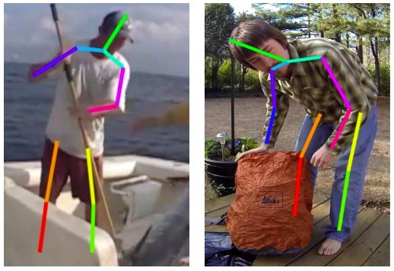
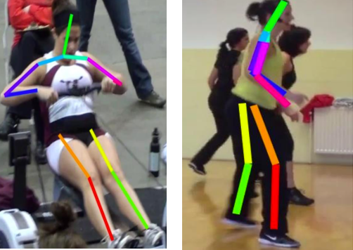
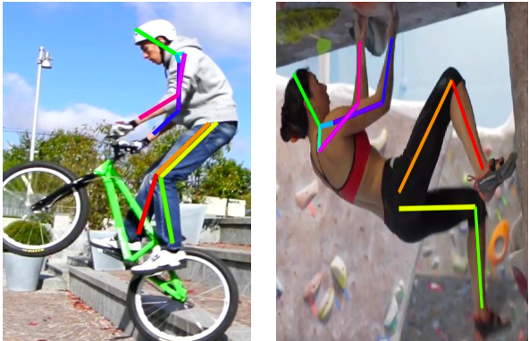
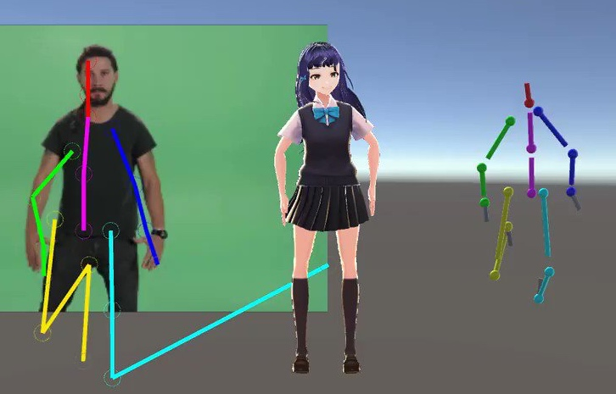
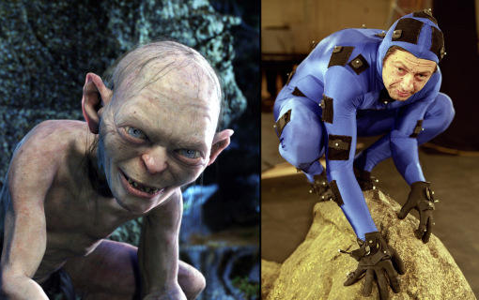
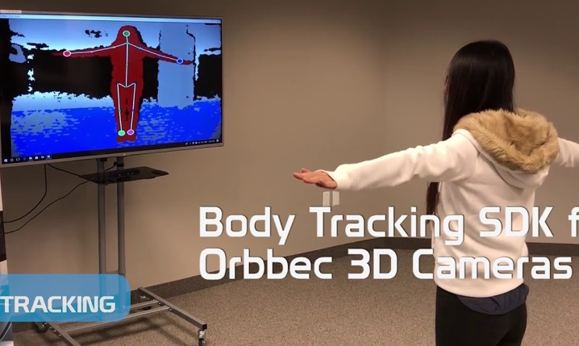
Occlusion
Complex background
Special pose
Animation
Motion Capture and Augmented Reality
Gaming

Slide 2
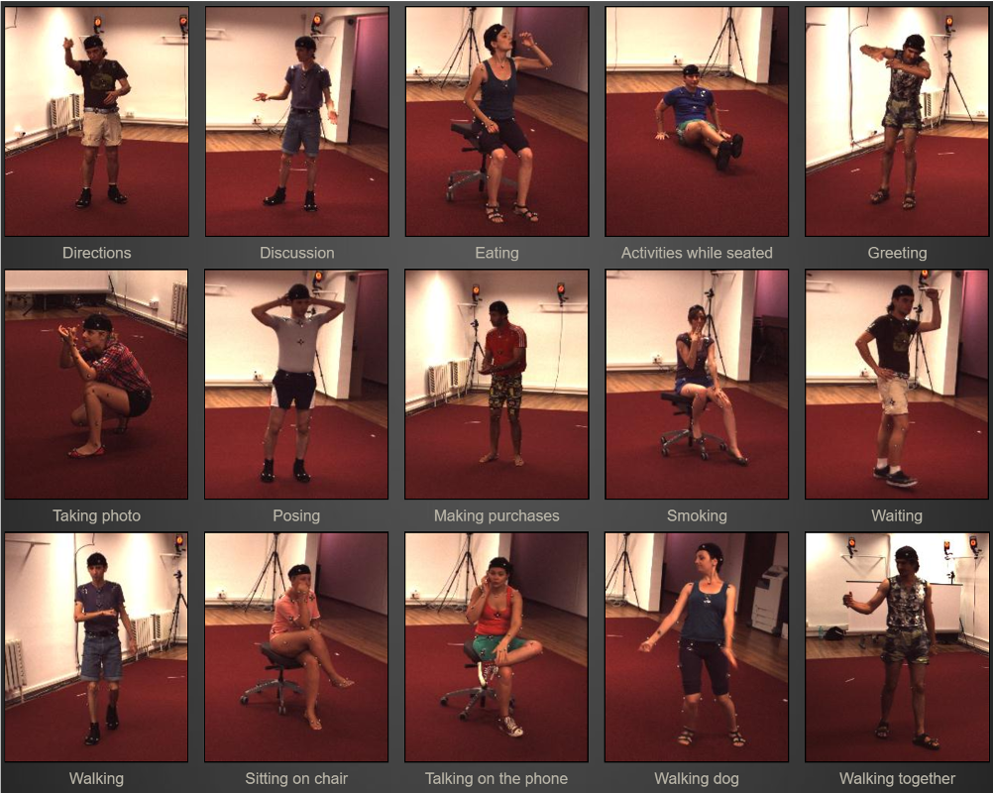
Human3.6M

Slide 3
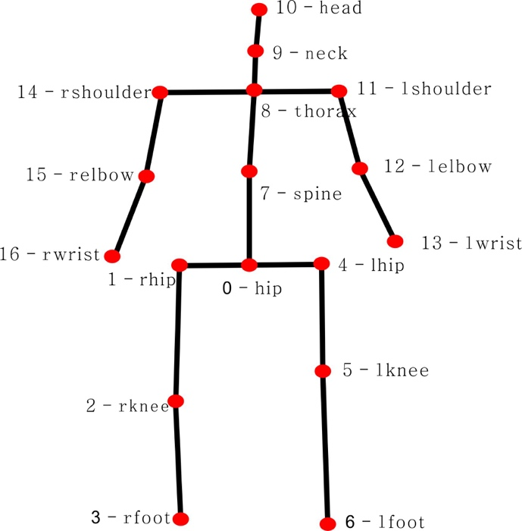
The 17 joints of a human pose

Slide 4
A Motion Capture system used to build 3D pose dataset

Slide 5
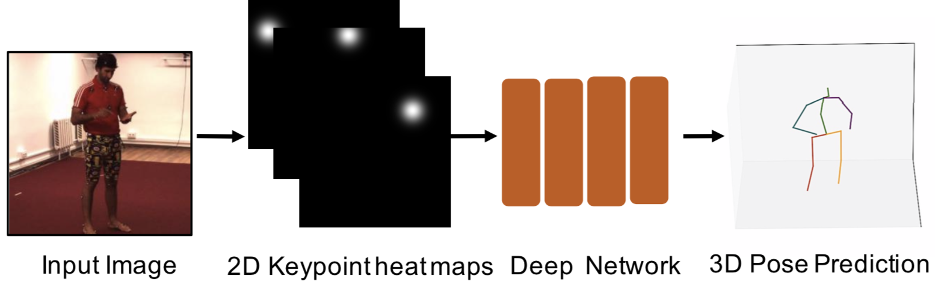
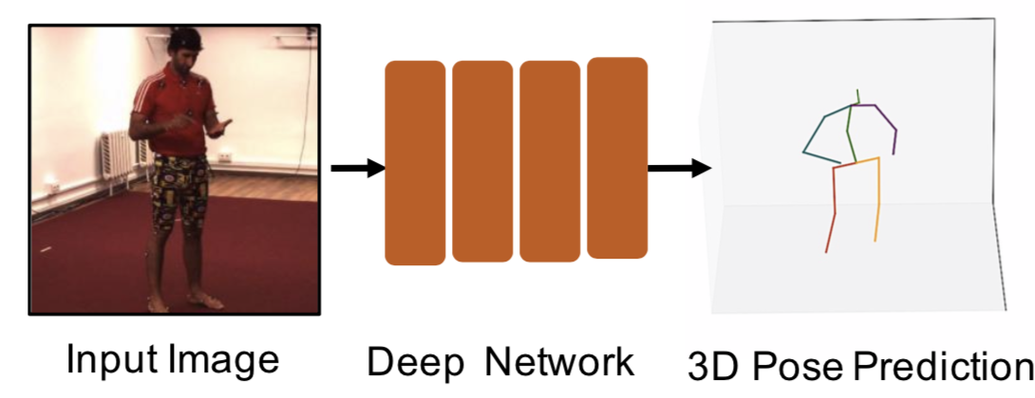
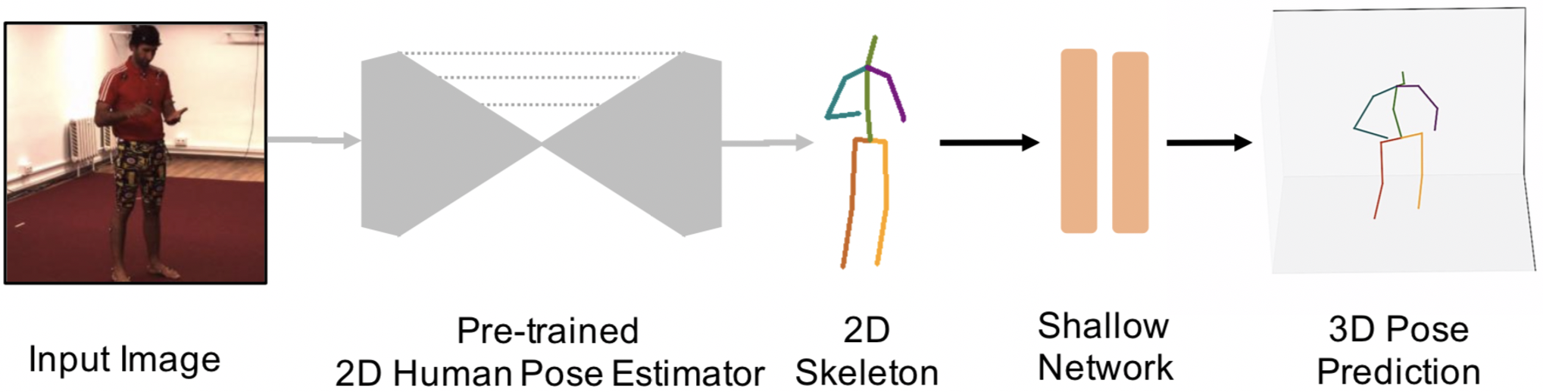
(a) Directly regress the 3D poses from monocular images
(b) Joint 2D and 3D: lift 3D pose from
the estimated 2D joint position
(c) 3D pose estimation using only 2D joint detections as input

